Slide 1
HEART DISEASE PREDICTION USING MACHINE LEARNING

Slide 2
ABSTRACT
In today’s era deaths due to heart disease has become a major issue approximately one person dies per minute due to heart disease.
This is considering both male and female category and this ratio may vary according to the region also this ratio is considered for the people of age group 25-69.
This does not indicate that the people with other age group will not be affected by heart diseases.
This problem may start in early age group also and predict the cause and disease is a major challenge nowadays.
in this project, we develop a GUI based system for predicting heart disease.

Slide 3
Domain overview:
Machine learning is to predict the future from past data. Machine learning (ML) is a type of artificial intelligence (AI) that provides computers with the ability to learn without being explicitly programmed
Machine learning focuses on the development of Computer Programs that can change when exposed to new data and the basics of Machine Learning, implementation of a simple machine learning algorithm using python. Process of training and prediction involves use of specialized algorithms.
It feed the training data to an algorithm, and the algorithm uses this training data to give predictions on a new test data.

Slide 4
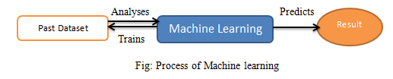

Slide 5
SYSTEM ANALYSIS

Slide 6
EXISTING SYSTEM
In hospitals doctors use many procedures which are costly to find heart diseases.
These techniques include stress test, chest x-ray, computed tomography (CT), nuclear scanning, echocardiogram (heart ultrasound), or magnetic resonance (MR). ... A wide range of modalities may also be used to monitor patients with heart disease/damage during and after treatment, including: Electrocardiogram (ECG or EKG)
DRAWBACKS:
Many patients cant afford huge amount for tests.
Some times even after verifying testing reports its difficult to say that a patient has heart disease or not..

Slide 7
PROPOSED SYSTEM
In our proposed concept, we can give new Heart data for patient as input to our algorithms.
The algorithms will predict weater patient has risk of heart attack or not.
Advantages:
Our goal is push for assisting doctors and patients using our predictions. All these publications state they have done better than their competitors but there is no article or public mention of their work being used practically to assist the doctors.
If there are some genuine problems in rolling out that work to next stage, then identify those problems and try solving them.

Slide 8
Application:
medical sector to automate to identify the heart disease (real time world) and predicting by desktop application / web application.
Overview of the system:
This helps all others department to carried out other formalities.
It have to find Accuracy of the training dataset, Accuracy of the testing dataset, Specification, False Positive rate, precision and recall by comparing algorithm using python code.

Slide 9
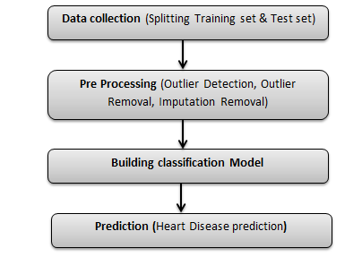
STEPS INVOLVED IN BUILDING ML MODEL

Slide 10
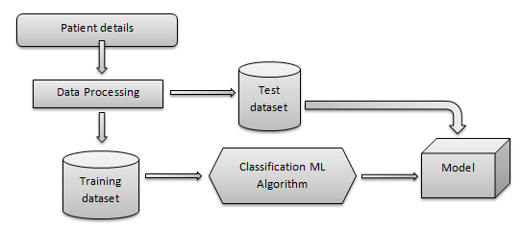
ARCHITECTURE OF PROPOSED MODEL

Slide 11
Software Requirements:
Operating System : Windows
Tool : Anaconda with Jupyter Lab
Hardware requirements:
Processor : Pentium IV/III
Hard disk : minimum 80 GB
RAM : minimum 2 GB

